Slide 1
SUIT
IETF 104 Hackathon Report

Slide 2



Software Update for IoT (suit)
Architecture &metadata for IoT firmware updates (also on small microcontrollers!)
Hands-on work on latest metadata draft draft-moran-suit-manifest-04
IoT Software Maintainer
network
IoT Device

Slide 3
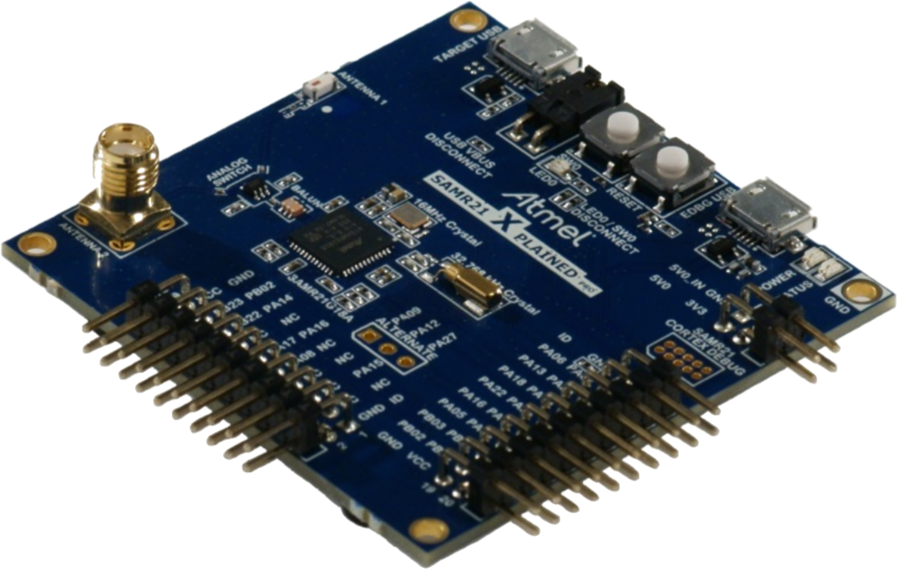
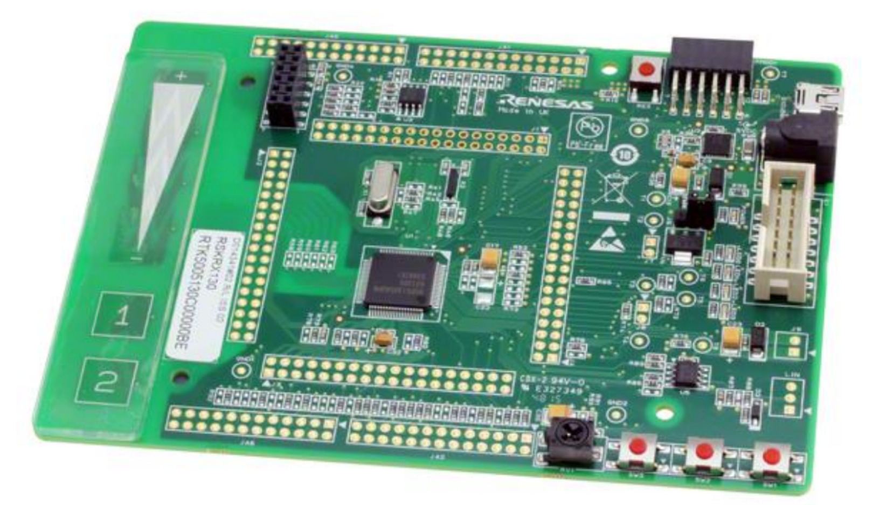

What happened at the Hackathon?
Manifest generators!
2 independent implementations (ARM, Renesas)
Manifest parsers!
3 independent implementations (Inria, ARM, Renesas)
2 of which running on micro-controllers
Interoperability!
Manifest generator (ARM) <=> parsers from Inria & Renesas
Full workflow demonstrated!
Based on RIOT
Microchip SAMR21
Cortex-M0+
32kB RAM, 256kB ROM
Renesas Starter Kit
RX231
64kB RAM

Slide 4
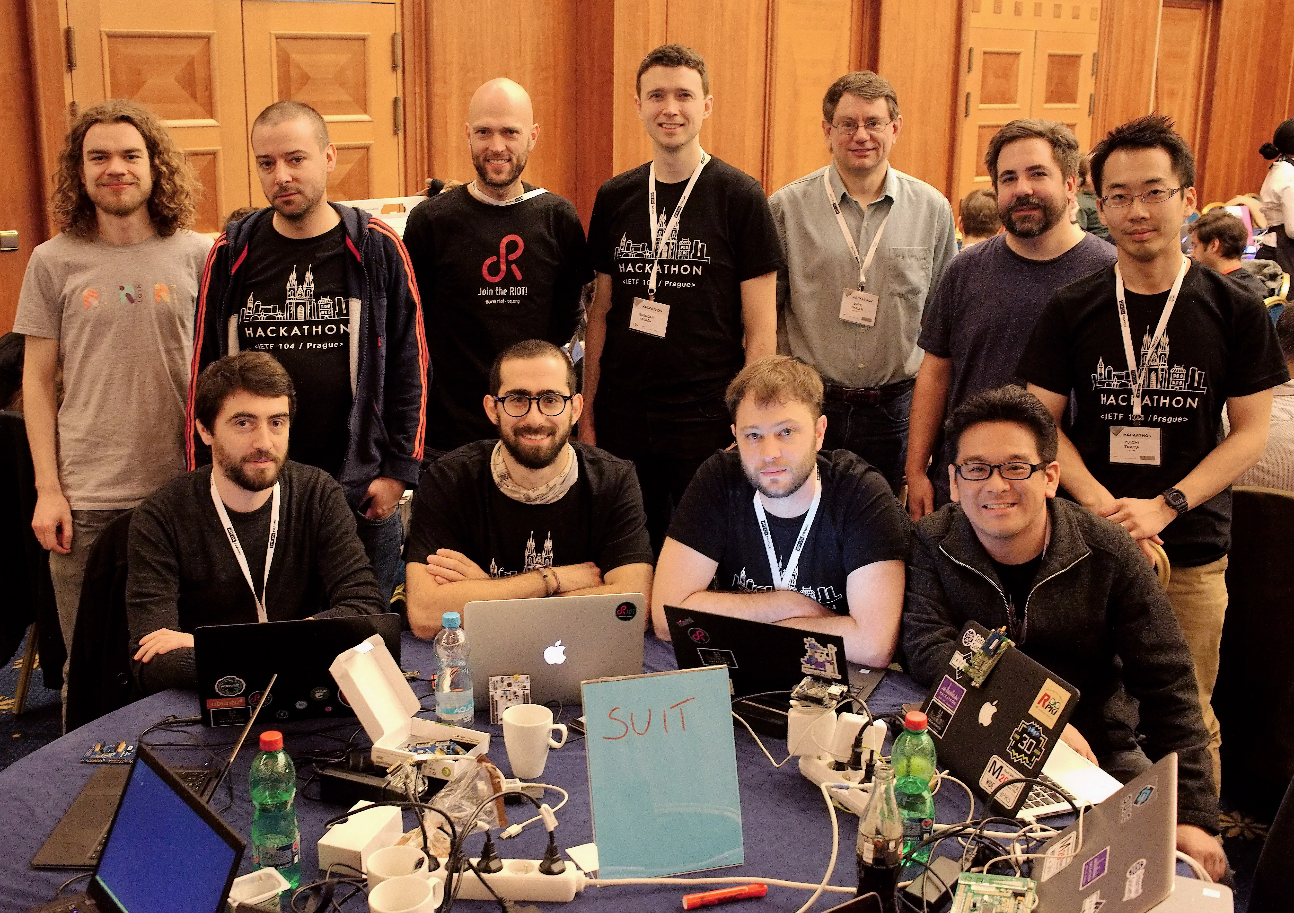
SUIT Hackathon Team!

